Slide 1
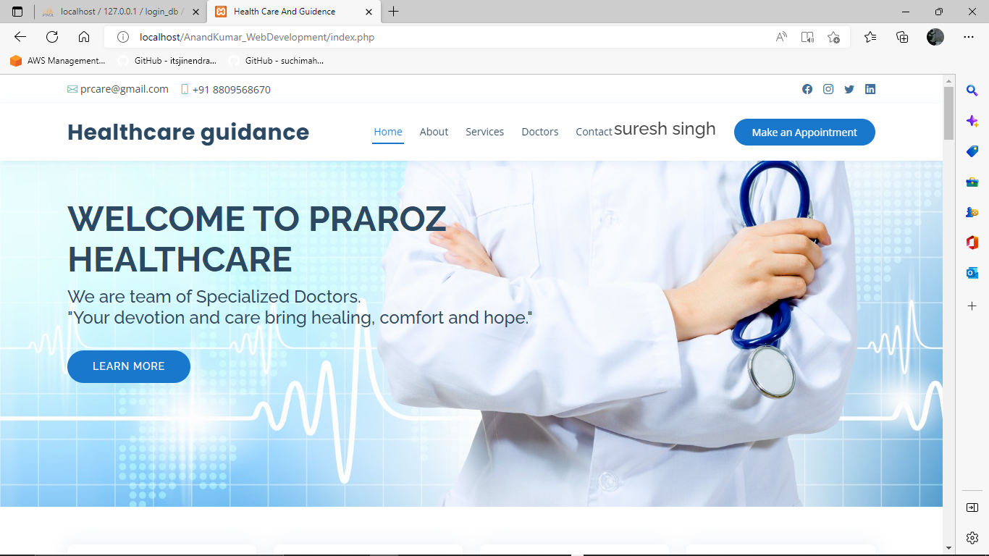
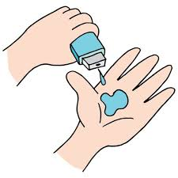
FSD PROJECT
Final Project
AICTE batch2

Slide 2
HEALTHCARE AND GUIDANCE

Slide 3

AGENDA
We are working on a HealthCare Guidance Website for health care sector. Everyone wants appointment with a good doctor on time but it’s also a difficult task for the patients to get a appointment on required time with a good doctor. To bridge the gap between this we decided to build a healthcare and guidance website.
Healthcare Guider Website is basically useful to any person who wants to save time and take doctors appointment online mode and also opt for online consulation through video chat and voice call. Patients can also make online payments to doctor through there UPI ID or net banking . All the data of patients doctors and patients appointment will be stored in different tables of database and can be fetched on the website. To use and acess all the features of website user have to login through his/her email id.

Slide 4

PROBLEM STATEMENT
HEALTHCARE GUIDANCE

Slide 5

PROJECT OVERVIEW
Healthcare Guider Website is basically useful to any person who wants to save time and take doctors appointment online mode and also opt for online conciliation through video chat and voice call. After getting appointment from the doctor the conformation email will be provided to both patients and the doctor, inside that email all the details of patients will be provided to the doctor with appointment timing and a meeting joining link of Google meet and the details of doctors will be sent to the patients with appointment timing and Google meet link for the meeting. All the appointments of the user will be stored in appointment table and is fetched to website in Appointments menu.

Slide 6

WHO ARE THE END USERS?
. Patients
. Doctors
. Anyone

Slide 7

YOUR SOLUTION AND ITS VALUE PROPOSITION
All the appointments of the user will be stored in appointment table and is fetched to website in Appointments menu. User can also cancel and change appointment. Patients can also make online payments to doctor through there UPI ID or net banking . All the data of patients doctors and patients appointment will be stored in different tables of database and can be fetched on the website. To use and access all the features of website user have to login through his/her email id. And new user can Signup through their email id .Full email validation will be used ,no email registered before will be used to signup, they can only login not signup full account security will be given to every user.
I used PHP and Mysql as Backed language to fetch and operate data and for Frontend i Have used HTML ,CSS, Javascript and Bootstrap . I have also used Xampp Apache server And Phpmyadmin to create SQL database and to connect backend and frontend i have used php as a backend language and run it on localhost of browser.

Slide 8

THE WOW IN YOUR SOLUTION
The main feature of this app is that it provides a good platform to create a clear communication between doctors and patients.
All the patients have free access to chat with the doctors they have taken appointment.
Taking appointment through our website is easy and time saving.
The website UI is fully user friendly and easy to use.
It fetches data very fast reload time is not so disturbing.
All the user data are managed and fetched very carefully without any data leakage with fill security. User password data is stored in the form of password hash so that only user can know it.

Slide 9
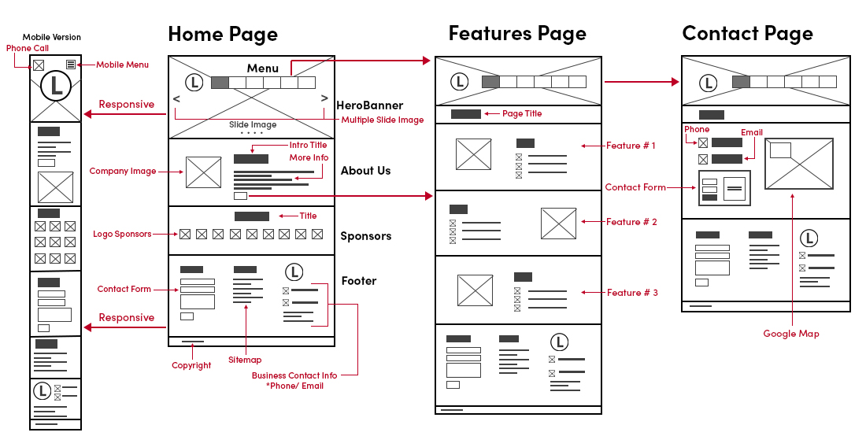
MODELLING
Teams cam add wireframes

Slide 10

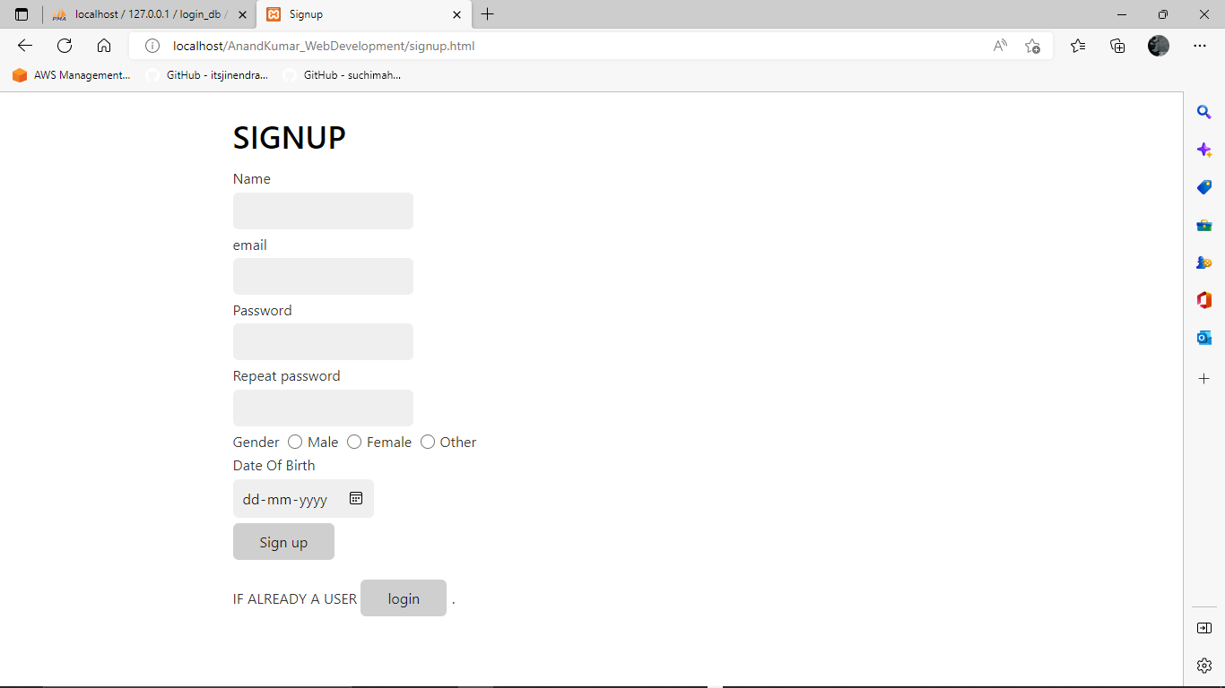
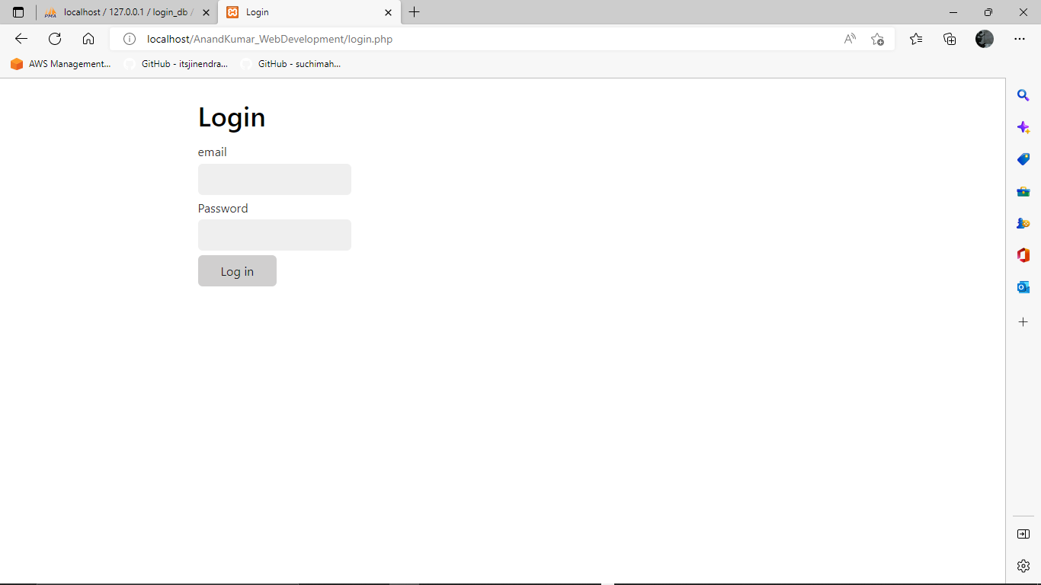
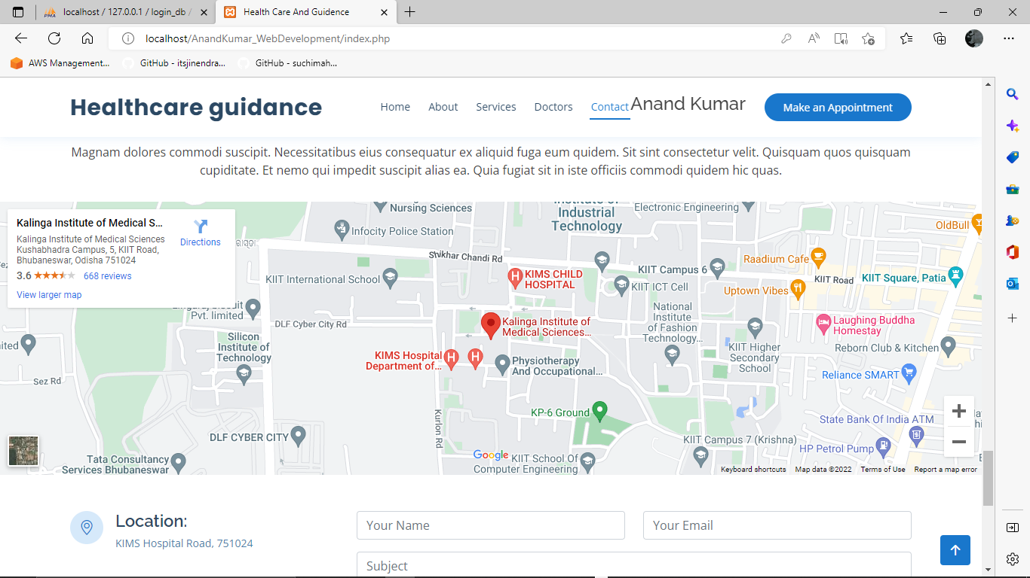
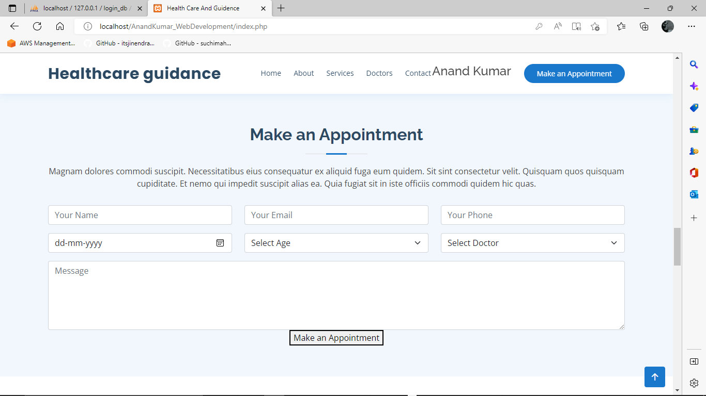
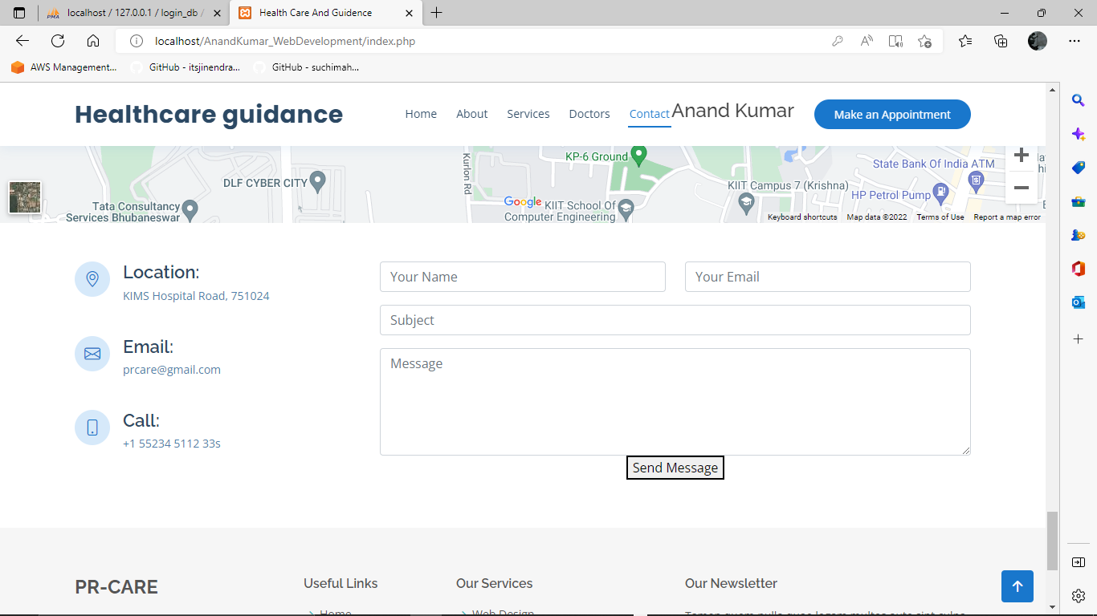
RESULTS
Demo Link

Slide 11
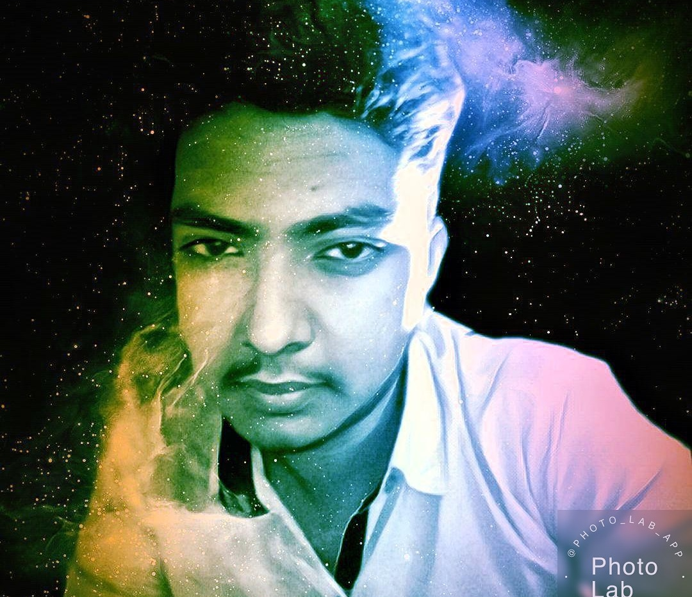
Made by
Anand Kumar
.
.

